Slide 1
Debrief 29/03/23

Slide 2
Programme for 30th March 2023 (Thursday)
Time | Event | Venue
9.50am | Report to Republic Poly | E1 6T
10am -10.30am | Wellness | E1 6T
10.30pm – 12.30pm | Corporate Project (Project Proposal) | E1 6T – Kinjo rubber LIBN1 – MSD LIBN2 – foodpanda LIBN3 – EVCO LIBN4 - Micron
12.30pm – 2pm | Lunch
2pm – 4pm | Corporate Project (Project Proposal Submission to sponsor)
4.15pm – 4.30pm | Debrief | E16T
Things to Bring: Laptop with Charger, money for lunch, writing materials and handphone
Wear: Smart Casual

Slide 3
High Element Declaration Submission (By Today!)
Bennington
Desmond
Gerard
Christina
Ethan
Ari

Slide 4
High Element Parental Consent Form
Please get your parent's acknowledgement regardless of your age.
Please do not forged your parent's signature (this is a criminal offence)
To return the form by tomorrow 30th March 2023

Slide 5
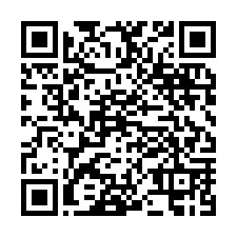
Week 3 Survey
https://tomowork.typeform.com/to/SXB3Z6HQ

Slide 6
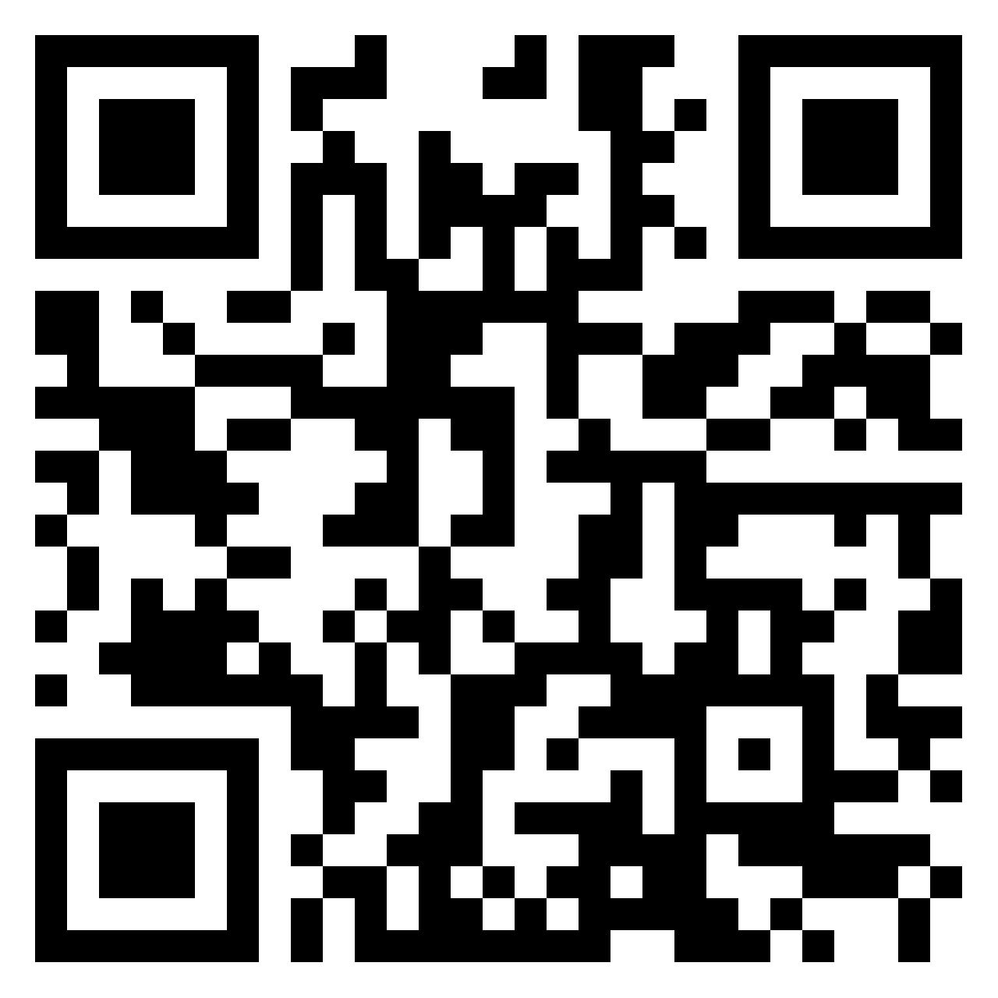
Week 3 Reflection
https://padlet.com/woeiluen/tap-2023-weekly-reflection-week-3-55xk9c7jmt1f5pql

Slide 7
TomoWork’s Got Talent Documents
Completed Slides + Script
Practice Video
Music/Lyric Videos
Deadline: 3 April 2023 (Monday)

Slide 8
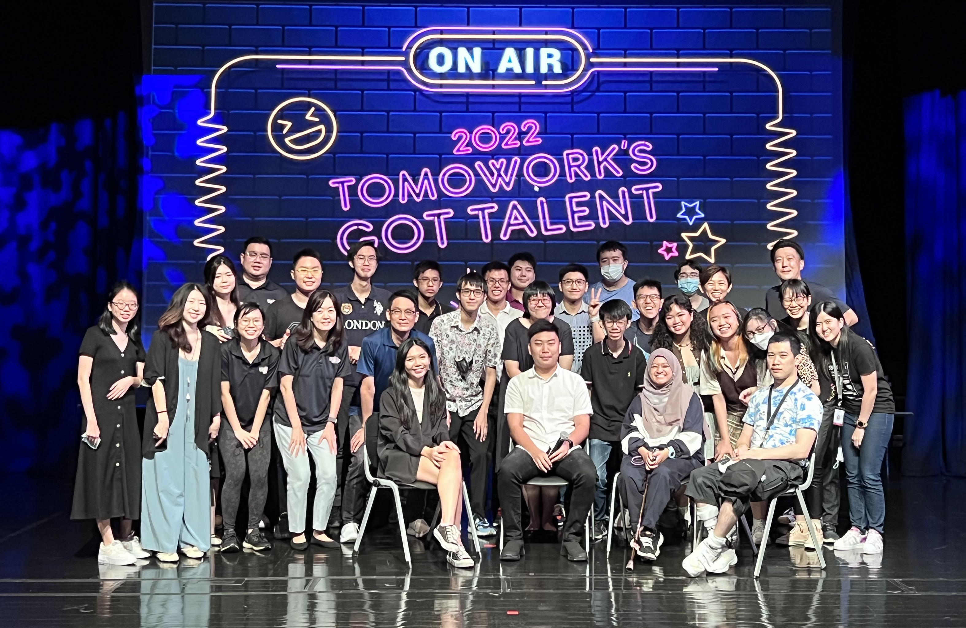
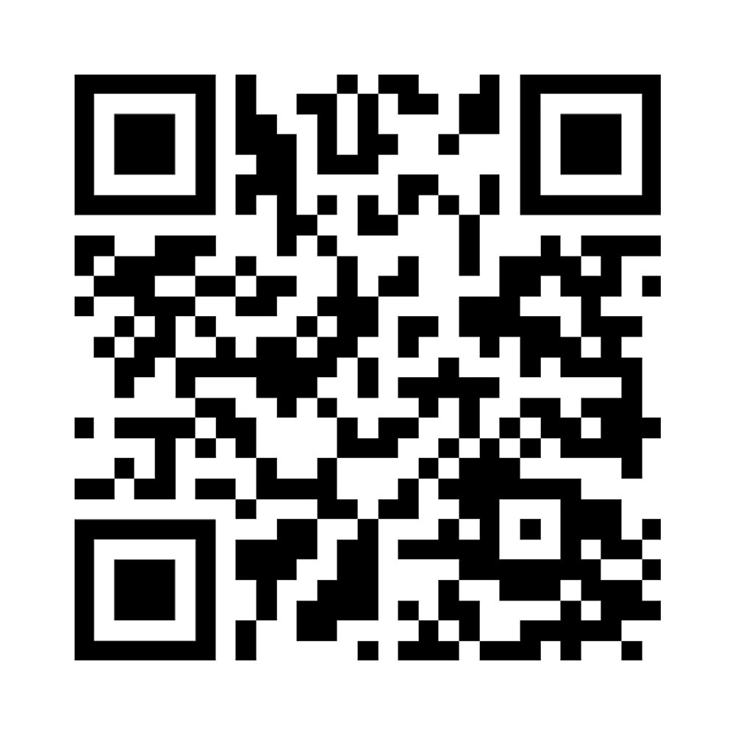
Submit TomoWork’s Got Talent Application (By Today) here:
https://tomowork.typeform.com/to/rIKEkJOm
Submit TomoWork’s Got Talent Practice Video here by 3 April Monday:
https://drive.google.com/drive/folders/1EZ7bUDGOdTUaKZPnGHp53bQxBNxdZypp?usp=sharing

